Slide 1

Intro to NServiceBus
5 – Distributed Transactions

Slide 2
Transaction support
NServiceBus is fully DTC enabled
By default, endpoints with AsA_Client have DTC disabled, and AsA_Server is enabled
If a transactional endpoint encounters and exception, NServiceBus will go through first and second level retries
If those all fail, then any transactions committed in the service will be rolled back, as wall as on any other wrapping transactions

Slide 3
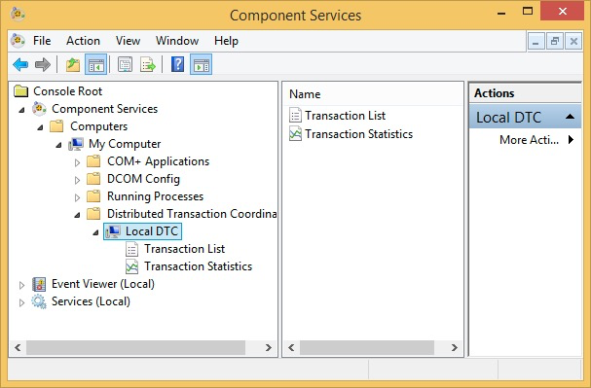
Things you need to do to support Distributed Transactions
Make sure DTC service is running
Make sure your endpoint is transaction enabled
That’s all

Slide 4
Demo: Transactional Processing

